Slide 1
Solutions to Chapter 2

Slide 2
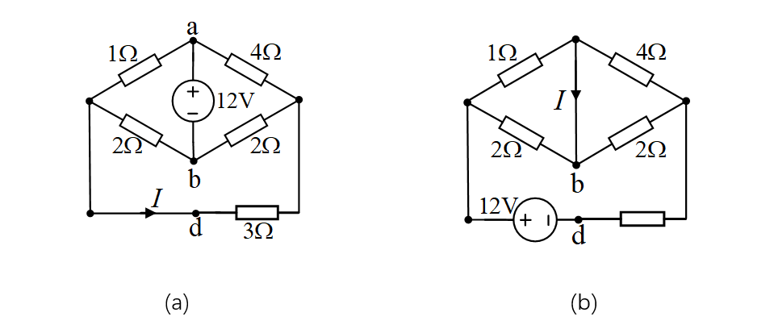
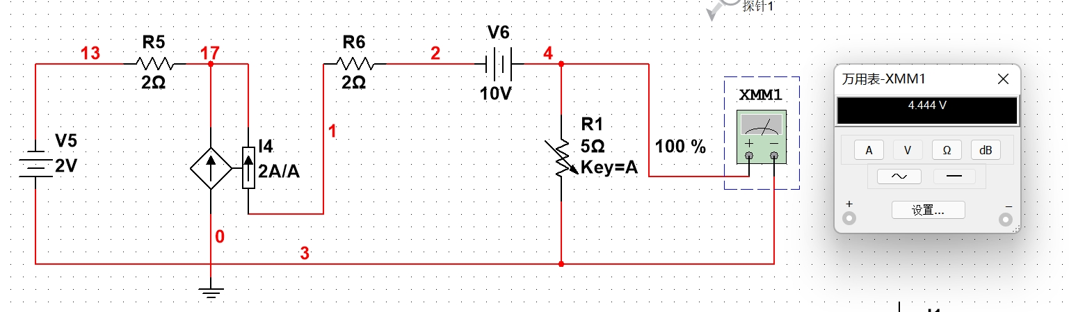

Slide 3
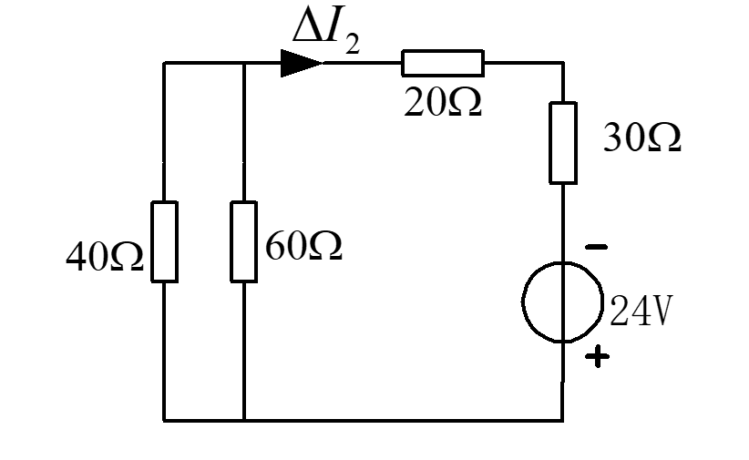

2.3 If the voltage of the 48V source drops to 24V, find the change caused in current i₂.
Solution
According to superposition, ΔI₂ results from change of 48 V voltage source directly.

Slide 4
2.4 Find I_{x} in figure P2-4 by using superposition.
Solution

Slide 5
2.5 In the circuit shown in Figure P2-5, N₀ is a linear passive network with unknown circuit structure. Given the following measurement results:
V_{s} =5 V, I_{s} =2 A, I₂=1A；and V_{s}=2V, I_{s}=4A, I₂=2A. Determine I₂ when
V_{s}=1V and I_{s}=1A.
Solution
Assuming
substitute given measurement results and get
When
obtain

Slide 6
2.7 Figure P2-7 shows an R-2R type resistor pack. Various equivalent resistors can be obtained by properly connecting its lead pins. All but one of the following resistance values are available : R/2，2R/3，R，8R/3，5R/3，2R，3R，4R . Find the value that is not available and draw the connections for other values.
Solution

Slide 8
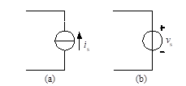
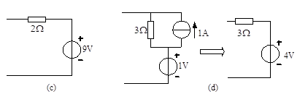
2.9 Simplify the circuits in figure P2-9.
Solution

Slide 9
2.10 The v-i relationship for the two-terminal circuit in Figure P2-10(a) is shown in Figure P2-10(b). Find the equivalent circuit for the two-terminal circuit.
Solution

Slide 10
2.11 Find v_{X} and i_{X} in Figure P2-11 by simplifying the circuit to its equivalent.
Solution

Slide 11
2.13 Use circuit transformation to find the equivalent circuit for the circuit in Fig. P2-13.
Solution

Slide 12
2.14 Find the input resistances for the circuits in fig. P2-14.
Solution
(a)
(b)

Slide 13
2-15. Use Tee-Pai transformation to find the equivalent resistors for the circuits in Fig. P2-15. The resistance of all resistors is 1 Ω
(a)
(b)

Slide 14
2.17 For the circuit in figure P2-17, (1) Find its Thevenin equivalent circuit. (2) Calculate the power absorbed by a 10Ω resistor connected to the terminals A and B. (3) Connect the positive terminal of a 5V voltage source to A and the negative end to B. Calculate the power delivered to this source.
Solution
(1)
(2)

Slide 15
(3) Connect 5Vvoltage source to terminal AB as shown in Fig.(c) and find

Slide 16
2.18 For the circuit in figure P2-18, the voltage v₂ is 12.5V. If terminal a and b are short-circuited, the short-circuit current from a to b is I_{SC}=10mA. Find the equivalent circuit of N seen at a-b terminals.
Solution
(1) Disconnect a-b and find the Norton equivalence.
(2) Assume the Norton equivalence of network N and apply given conditions.

Slide 17
2.19 Find the Thevenin equivalent circuit for the circuit in figure P2-19.
Solution
Transform the circuit in Fig. P2-19 into the following circuit (a)：
I
(1)Find Voc，apply KCL, get

Slide 18
2.19 Find the Thevenin equivalent circuit for the circuit in figure P2-19.
Solution
(2)Determine R₀
I
Isc
Assuming , get

Slide 19
2.22 For the circuit in figure P2-22, find a load R_{L} that draws maximum power from the circuit, and calculate this maximum power.
Solution (1) Remove R_{L} and find V_{OC}.
(2) Assuming v₀=1V, get

Slide 20
2.23 The node equations for a circuit are as following. Draw a circuit that satisfies the equations.
Solution

Slide 21
2.24 Use nodal analysis to find V_{a}, V_{b} and V_{c} for the circuit in figure P2-24.
Solution

Slide 22
2.29 Use mesh analysis to repeat the calculations in problem 2.26.
Solution

Slide 23
2.32 Use both nodal and mesh analysis to find I_{A} and the power of the dependent source in the circuit of figure P2-32.
Solution

Slide 24
Nodal analysis

Slide 25
2.33 Use nodal or mesh analysis to find V_{A} and I_{B} in figure P2-33.
Solution (1) nodal analysis
1
2
3
4

Slide 26
(2) Mesh analysis
Super mesh 1
Mesh 2
Constraint equation

Slide 27
2-34. For the circuit of figure P2-34
Find the relation of v_{o} to v_{s1} and v_{s2 .}
Determine v_{o} if v_{s1} = 6V and v_{s2} = 3V..
Solution
i₋= i₊= 0 , v₊ = v₋ = v_{s1}
Write nodal equation at v-

Slide 28
2.36 For the circuit of figure P2-36
(1) Find the relation of v_{o} to v_{s} .
(2) If v_{S} =1.5V, compute the power supplied by voltage source and the power delivered to the 5-kΩ load resistor.
Solution
i₋= i₊= 0 , v₊ = v₋ = v_{s}
Write nodal equation at v-

Slide 29
2.37 For the circuit in figure P2-37, use nodal analysis to find the voltage gain v_{o} /v_{s}, and use EWB simulation to verify the result.
Solution
i₋= i₊= 0 , v_{B+} = v_{B-} = 0
Write nodal equations at B and E

Slide 30
2.38 For the circuit in figure P2-38
(1) Use nodal analysis to find the voltage gain v_{o} /v_{i}.
(2) Find the input resistor seen by the voltage source v_{i}.
Solution
i
v₊
i₋= i₊= 0 , v₊ = v₋
v₁
v₋
Write nodal equations at v₁ , v₊ and v₋

